Slide 1

Web/iOS Development
Shyne
2014.10.17

Slide 2

Today
Homework questions?
  http://stackoverflow.com/questions/16860108/how-to-determine-if-the-first-character-of-a-nsstring-is-a-letter
Apple developer account
Program stack trace
Values and collections
  Primitive types
  collections
    NSArray
    NSDictionary
Object graph

Slide 3
[Stack trace]

Slide 4
Objects can send messages to themselves
Whenever you’re writing a method implementation, you have access to an important hidden value, self. Conceptually, self is a way to refer to “the object that’s received this message.” It’s a pointer, just like the greeting value above, and can be used to call a method on the current receiving object.
    @implementation XYZPerson
    - (void)sayHello {
    [self saySomething:@"Hello, world!"];
    }
    - (void)saySomething:(NSString *)greeting {
    NSLog(@"%@", greeting);
    }
    @end

Slide 5
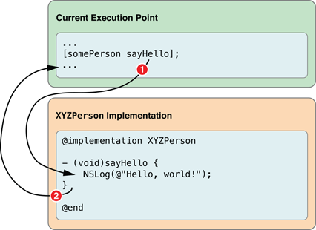
Objects send and receive messages
[somePerson sayHello];

Slide 6
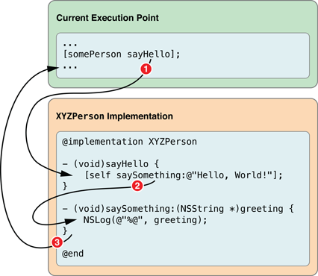
Objects send and receive messages
[somePerson saySomething:@”Hi”];

Slide 7
Objects can call methods implemented by their superclasses
@interface XYZShoutingPerson : XYZPerson
@end
@implementation XYZShoutingPerson
- (void)saySomething:(NSString *)greeting {
NSString *uppercaseGreeting = [greeting uppercaseString];
NSLog(@"%@", uppercaseGreeting);
}
@end

Slide 8
Objects send and receive messages
What happens when you call the following function?
  XYZPerson *person = [[XYZPerson alloc] init];
  [somePerson saySomething:@”Hi”];
And now?
  XYZShoutingPerson *person = [[XYZPerson alloc] init];
  [somePerson saySomething:@”Hi”];

Slide 9
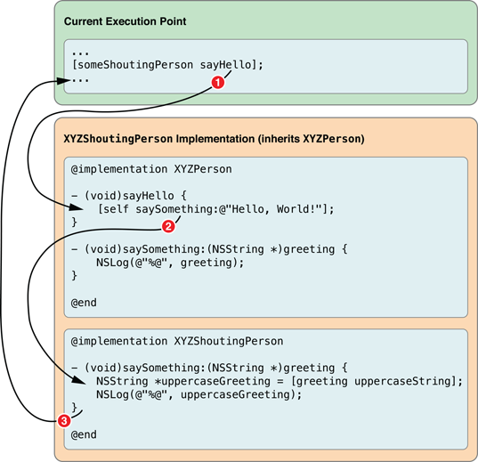
Objects send and receive messages
And now?
  XYZShoutingPerson *person
  = [[XYZPerson alloc] init];
  [somePerson sayHello];

Slide 10
Objects can call methods implemented by their superclasses
@interface XYZShoutingPerson : XYZPerson
@end
@implementation XYZShoutingPerson
- (void)saySomething:(NSString *)greeting {
NSString *uppercaseGreeting = [greeting uppercaseString];
[super saySomething:uppercaseGreeting];
}
@end

Slide 11
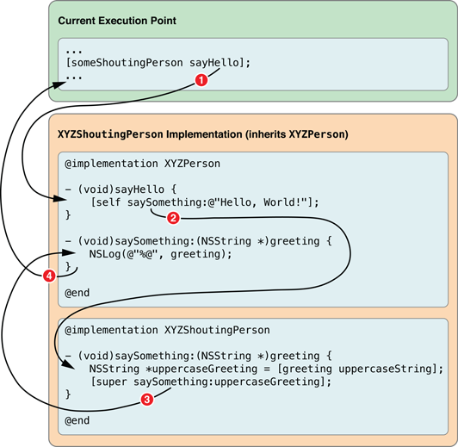
Objects send and receive messages
And now?
  XYZShoutingPerson *person
  = [[XYZShoutingPerson alloc] init];
  [somePerson sayHello];

Slide 12
Stack trace in Xcode
Hide navigation top bar
  [self.navigationController setNavigationBarHidden:YES animated:NO];
UIBarButtonItem
Unwind segue
Example
  Break point

Slide 13
[Values and collections]

Slide 14
Primitive types
Although Objective-C is an object-oriented programming language, it is a superset of C, which means you can use any of the standard C scalar (non-object) types like int, float and char in Objective-C code.
There are also additional scalar types available in Cocoa and Cocoa Touch applications, such as NSInteger, NSUInteger and CGFloat, which have different definitions depending on the target architecture.
Examples:
    int someInteger = 42;
    float someFloatingPointNumber = 3.1415;
    double someDoublePrecisionFloatingPointNumber = 6.02214199e23;

Slide 15
Standard C operators are supported in Obj-C
Examples:
    int someInteger = 42;
    float someFloatingPointNumber = 3.1415;
    double someDoublePrecisionFloatingPointNumber = 6.02214199e23;
    int someInteger = 42;
    someInteger++; // someInteger == 43
    int anotherInteger = 64;
    anotherInteger--; // anotherInteger == 63
    anotherInteger *= 2; // anotherInteger == 126

Slide 16
Primitive types as properties
Declaration
  @interface XYZCalculator : NSObject
  @property double currentValue;
  @end
Methods
  @implementation XYZCalculator
  - (void)increment {
  self.currentValue++;
  }
  - (void)decrement {
  self.currentValue--;
  }
  - (void)multiplyBy:(double)factor {
  self.currentValue *= factor;
  }
  @end

Slide 17
BOOL scalar type
The BOOL scalar type is defined in Objective-C to hold a Boolean value, which is either YES or NO. As you might expect, YES is logically equivalent to true and 1, while NO is equivalent to false and 0.

Slide 18
NSString revisit
Create NSString objects – look up in help page!!!
  NSString *firstString = [[NSString alloc] initWithCString:"Hello World!"
  encoding:NSUTF8StringEncoding];
  NSString *secondString = [NSString stringWithCString:"Hello World!"
  encoding:NSUTF8StringEncoding];
  NSString *thirdString = @"Hello World!";
Mutable string?
NSString *name = @"John";
name = [name stringByAppendingString:@"ny"]; // returns a new string object
NSMutableString *name = [NSMutableString stringWithString:@"John"];
[name appendString:@"ny"]; // same object, but now represents "Johnny"

Slide 19
NSNumber
The NSNumber class is used to represent any of the basic C scalar types, including char, double, float, int, long, short, and the unsigned variants of each, as well as the Objective-C Boolean type, BOOL.
Examples:
  NSNumber *magicNumber = [[NSNumber alloc] initWithInt:42];
  NSNumber *unsignedNumber = [[NSNumber alloc] initWithUnsignedInt:42u];
  NSNumber *longNumber = [[NSNumber alloc] initWithLong:42l];
  NSNumber *boolNumber = [[NSNumber alloc] initWithBOOL:YES];
  NSNumber *simpleFloat = [NSNumber numberWithFloat:3.14f];
  NSNumber *betterDouble = [NSNumber numberWithDouble:3.1415926535];
  NSNumber *someChar = [NSNumber numberWithChar:'T'];

Slide 20
NSNumber
Or, create NSNumber instances using Objective-C literal syntax
Examples:
  NSNumber *magicNumber = @42;
  NSNumber *unsignedNumber = @42u;
  NSNumber *longNumber = @42l;
  NSNumber *boolNumber = @YES;
  NSNumber *simpleFloat = @3.14f;
  NSNumber *betterDouble = @3.1415926535;
  NSNumber *someChar = @'T';

Slide 21
Collections
Collections are a group of NSObjects
Any item you wish to add to a collection must be an instance of an Objective-C class. If you need to add a scalar value, you must first create a suitable NSNumber or NSValue instance to represent it.
Rather than somehow maintaining a separate copy of each collected object, the collection classes use strong references to keep track of their contents. This means that any object that you add to a collection will be kept alive at least as long as the collection is kept alive
Popular ones: NSArray, NSSet and NSDictionary.

Slide 22
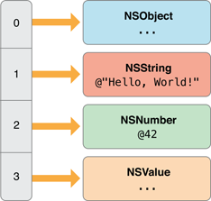
NSArray and NSMutableArray
An NSArray is used to represent an ordered collection of objects. The only requirement is that each item is an Objective-C object— there’s no requirement for each object to be an instance of the same class.

Slide 23
Create arrays
Use initialization/factory methods
  + (id)arrayWithObject:(id)anObject;
  + (id)arrayWithObjects:(id)firstObject, ...;
  - (id)initWithObjects:(id)firstObject, ...;
Literal Syntax
  NSArray *someArray = @[firstObject, secondObject, thirdObject];

Slide 24
Query one element in array
Use objectAtIndex method
  [someArray objectAtIndex:i]
Literal Syntax
  someArray[i];

Slide 25
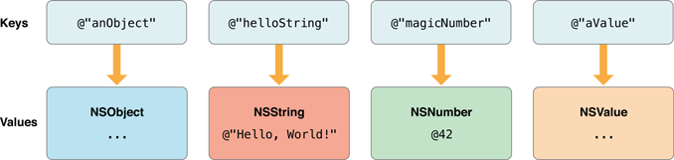
NSDictionary and NSMutableDictionary
Rather than simply maintaining an ordered or unordered collection of objects, an NSDictionary stores objects against given keys, which can then be used for retrieval.
It’s best practice to use string objects as dictionary keys

Slide 26
Creating dictionaries
Use initialization/factory methods
  NSDictionary *dictionary = [NSDictionary dictionaryWithObjectsAndKeys:
  someObject, @"anObject",
  @"Hello, World!", @"helloString",
  @42, @"magicNumber",
  someValue, @"aValue",
  nil];
Literal Syntax
  NSDictionary *dictionary = @{
  @"anObject" : someObject,
  @"helloString" : @"Hello, World!",
  @"magicNumber" : @42,
  @"aValue" : someValue
  };

Slide 27
Query one element in dictionary
Use objectAtIndex method
  NSNumber *storedNumber = [dictionary objectForKey:@"magicNumber"];
Literal Syntax
  NSNumber *storedNumber = dictionary[@"magicNumber"];

Slide 28
Example – create a customer array
Use getter to initialize array
  Lazy initialization
Store customers in the array
Retrieve customer info

Slide 29
[Object graph]

Slide 30
Objects and memory
Memory for Objective-C objects is allocated dynamically on the heap, which means you need to use pointers to keep track of an object’s address.
Unlike scalar values, it’s not always possible to determine an object’s lifetime by the scope of one pointer variable. Instead, an object must be kept active in memory for as long as it is needed by other objects.
Rather than trying to worry about managing the lifecycle of each object manually, you should instead think about the relationships between objects.

Slide 31
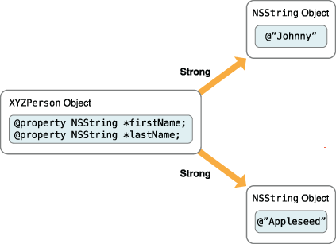
Objects and memory
When one object relies on other objects in this way, effectively taking ownership of those other objects, the first object is said to have strong references to the other objects. In Objective-C, an object is kept alive as long as it has at least one strong reference to it from another object.

Slide 32
Homework
TBD

Slide 33
~ END ~
http://www.alphacamp.tw

